Slide 1
Stock Classification Based on Annual Financial Report
By: Leonardo Leal Filho

Slide 2
Project objectives
Data Wrangling
Eliminate unwanted data
Select features to be used
Exploratory Data Analysis
Decipher the data
Machine Learning
Classification prediction

Slide 3
The data
Data
https://www.kaggle.com/cnic92/200-financial-indicators-of-us-stocks-20142018
Stock Market
Volatile
Highly affected
Interest rates, inflation, unemployment, etc.
Annual Financial Report
Is it helpful?

Slide 4
Data wrangling
5 years (2014 – 2018)
224 Features
Multiple repeat columns
2 index (year & stock)
Over 20,000 rows
75% or more null values removed
Feature Selection/Creation

Slide 5



Feature selection/creation
Profitability Features
Liquidity Features
Coverage Features

Slide 6

Profitability features
Return on Assets (ROA)
$\frac{Net Income}{Total Assets}$
Return on Equity (ROE)
$\frac{Net Income}{Shareholder^{′}s Equity}$
Profit Margin
$\frac{Revenue −Cost}{Revenue}$

Slide 7

Liquidity features
Current Ratio
$\frac{Current Assets}{Current Liabilities}$
Quick Ratio
$\frac{Current Assets − Inventory}{Current Liabilities}$
Cash Ratio
$\frac{Cash + Marketable Securities}{Current Liabilities}$

Slide 8

Coverage features
Debt Ratio
$\frac{Total Debts}{Total Assets}$
Debt to Equity Ratio
$\frac{Total Debts}{Shareholder^{′}s Equity}$
Interest Coverage Ratio
$\frac{Earnings Before Interest and Taxes (EBIT)}{Total Interest Expense}$
Cash Flow to Debt Ratio
$\frac{Cash Flow from Operations}{Total Debt}$

Slide 9
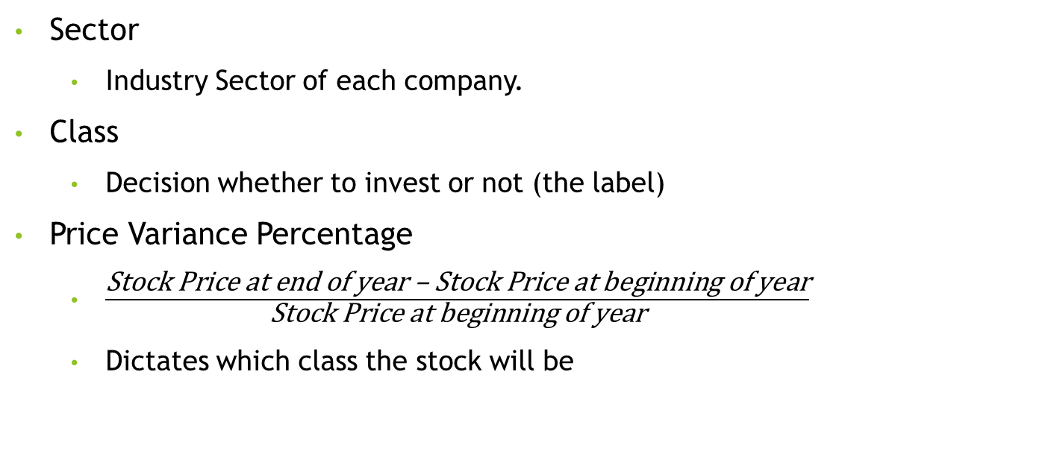
Additional Relevant Features
Sector
Industry Sector of each company.
Class
Decision whether to invest or not (the label)
Price Variance Percentage
$\frac{\text{Stock} \text{Price} \text{at} \text{end} \text{of} \text{year}\text{ – }\text{Stock} \text{Price} \text{at} \text{beginning} \text{of} \text{year}}{\text{Stock} \text{Price} \text{at} \text{beginning} \text{of} \text{year}}$
Dictates which class the stock will be

Slide 10
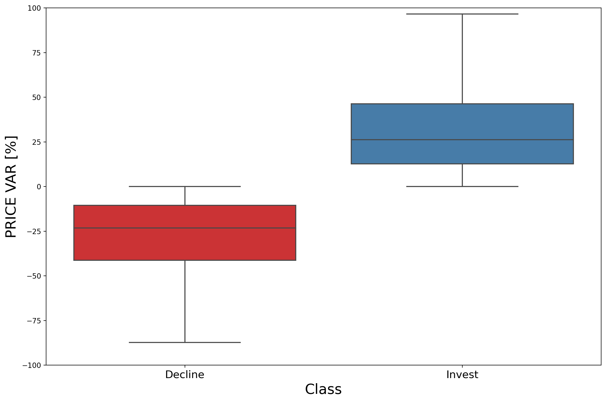
Exploratory Data Analysis

Slide 11
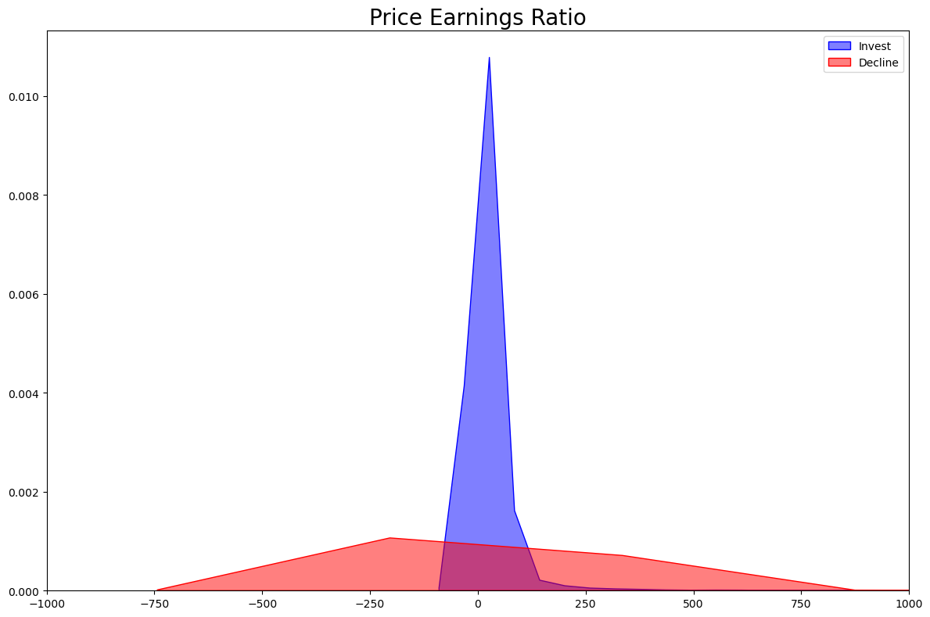
Exploratory Data Analysis
Some features demonstrated a clear difference in std.
Could signify that said features could be affected or affect other features.

Slide 12
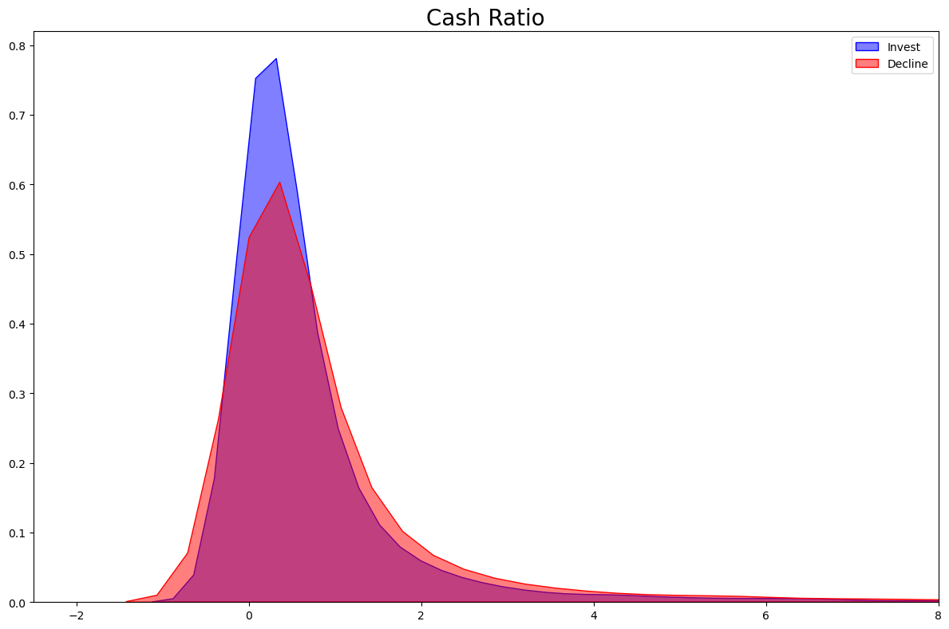
Exploratory Data Analysis
Some features demonstrated extremely similar distributions.
Permutation tests concluded there were a difference of means in some features.
The debt ratio being the only feature that did not “pass” the permutation test.

Slide 13
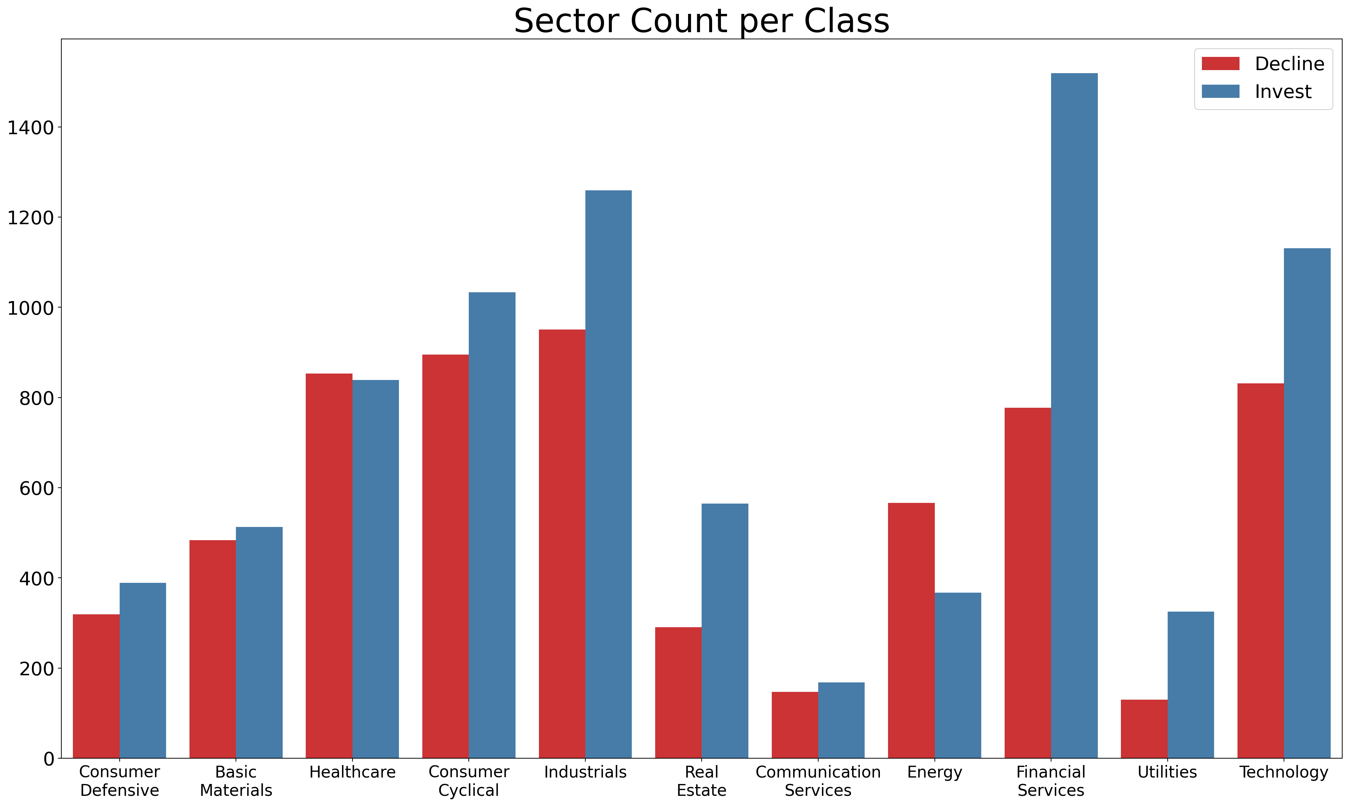
Exploratory Data Analysis
Most sectors can be considered evenly divided.
The invest decision has more sectors favoring said decision.
The standout sector being the Energy sector for being the only sector that so clearly favors the decline decision.

Slide 14
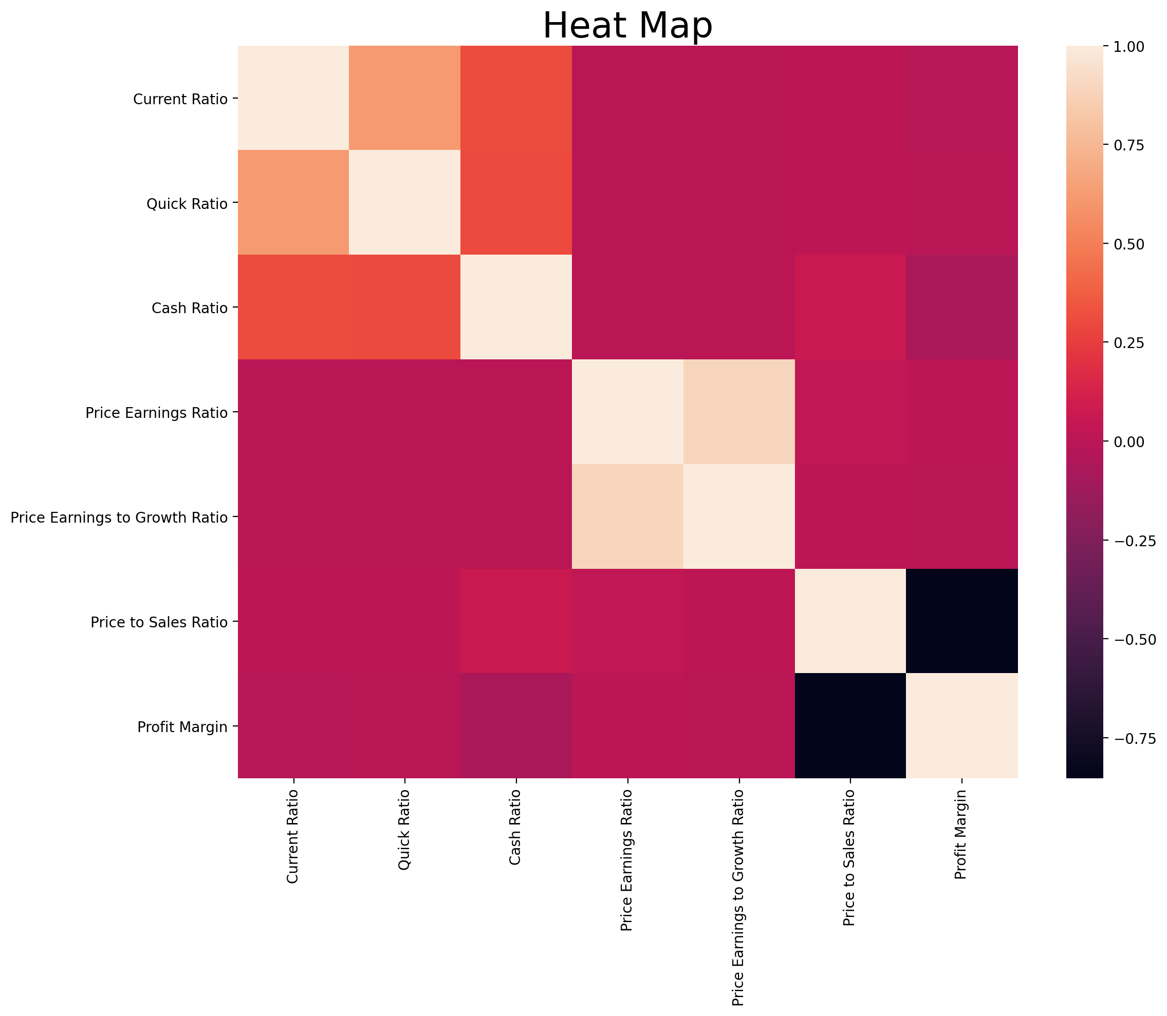
Exploratory Data Analysis
Some features have a considerable correlation rate.
Mostly considered a positive correlation.
Only Profit Margin and Price to Sales Ratio have a high negative correlation.

Slide 15
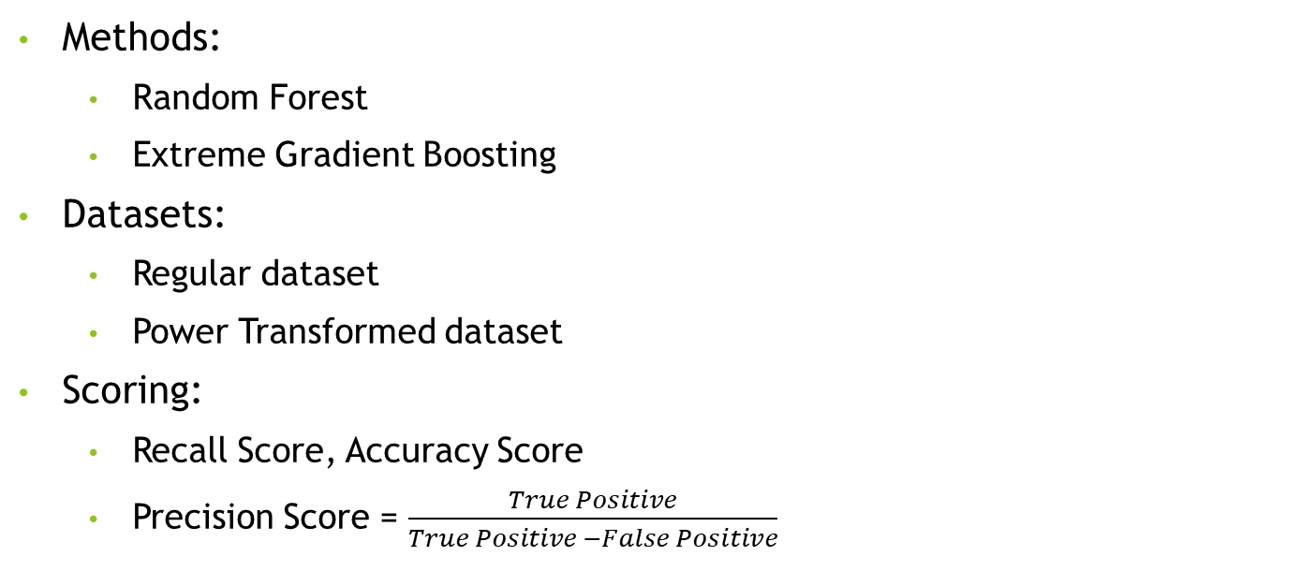
Machine Learning
Methods:
Random Forest
Extreme Gradient Boosting
Datasets:
Regular dataset
Power Transformed dataset
Scoring:
Recall Score, Accuracy Score
Precision Score = $\frac{True Positive}{True Positive −False Positive}$

Slide 16
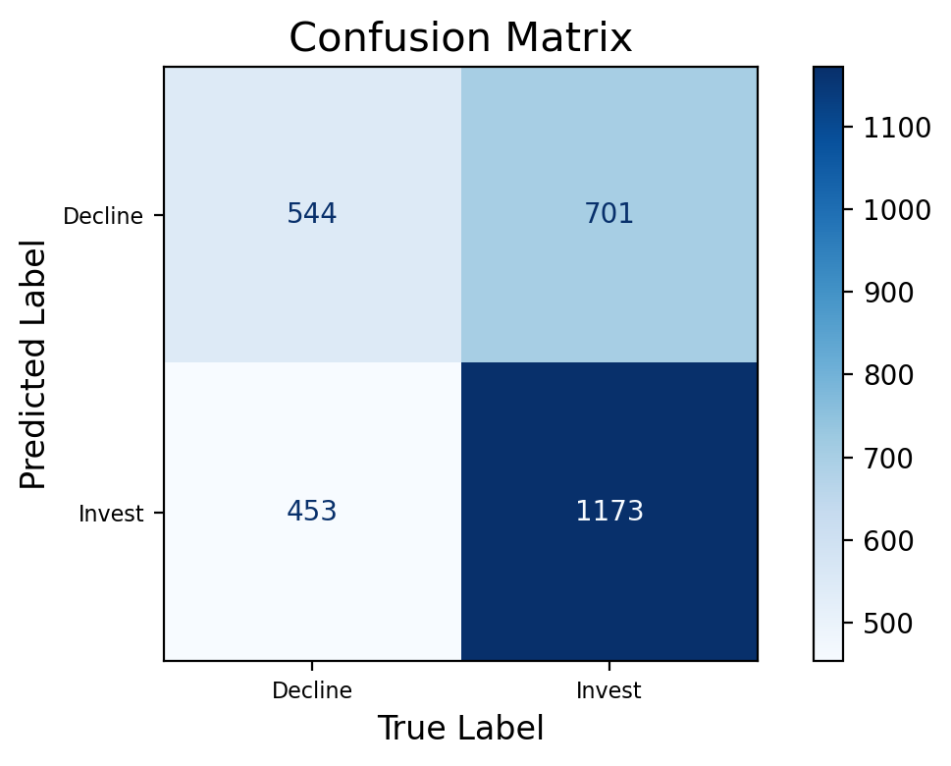
Machine Learning Results
Best Model
Extreme Gradient Boosting
Regular Dataset
Best Precision Score: 0.626
Specificity Score: 0.437

Slide 17
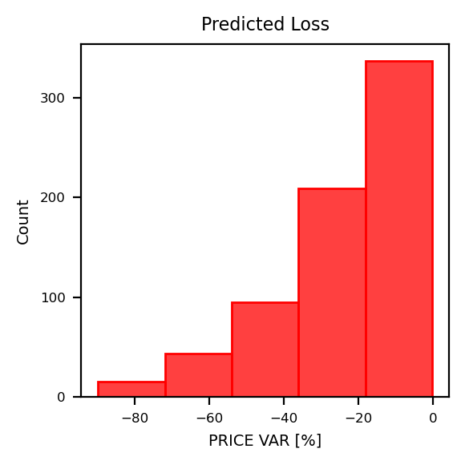
Machine Learning Results

Slide 18
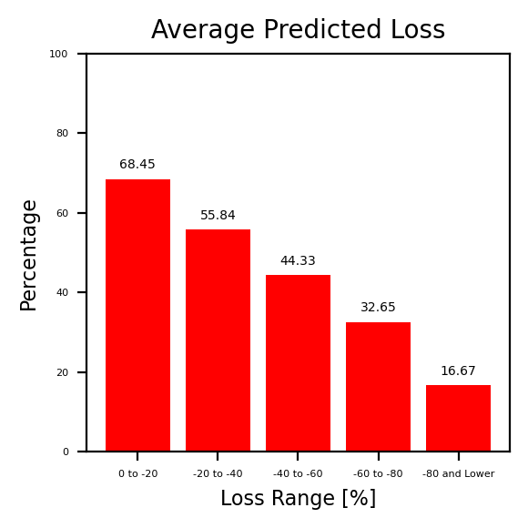
Machine Learning Results

Slide 19
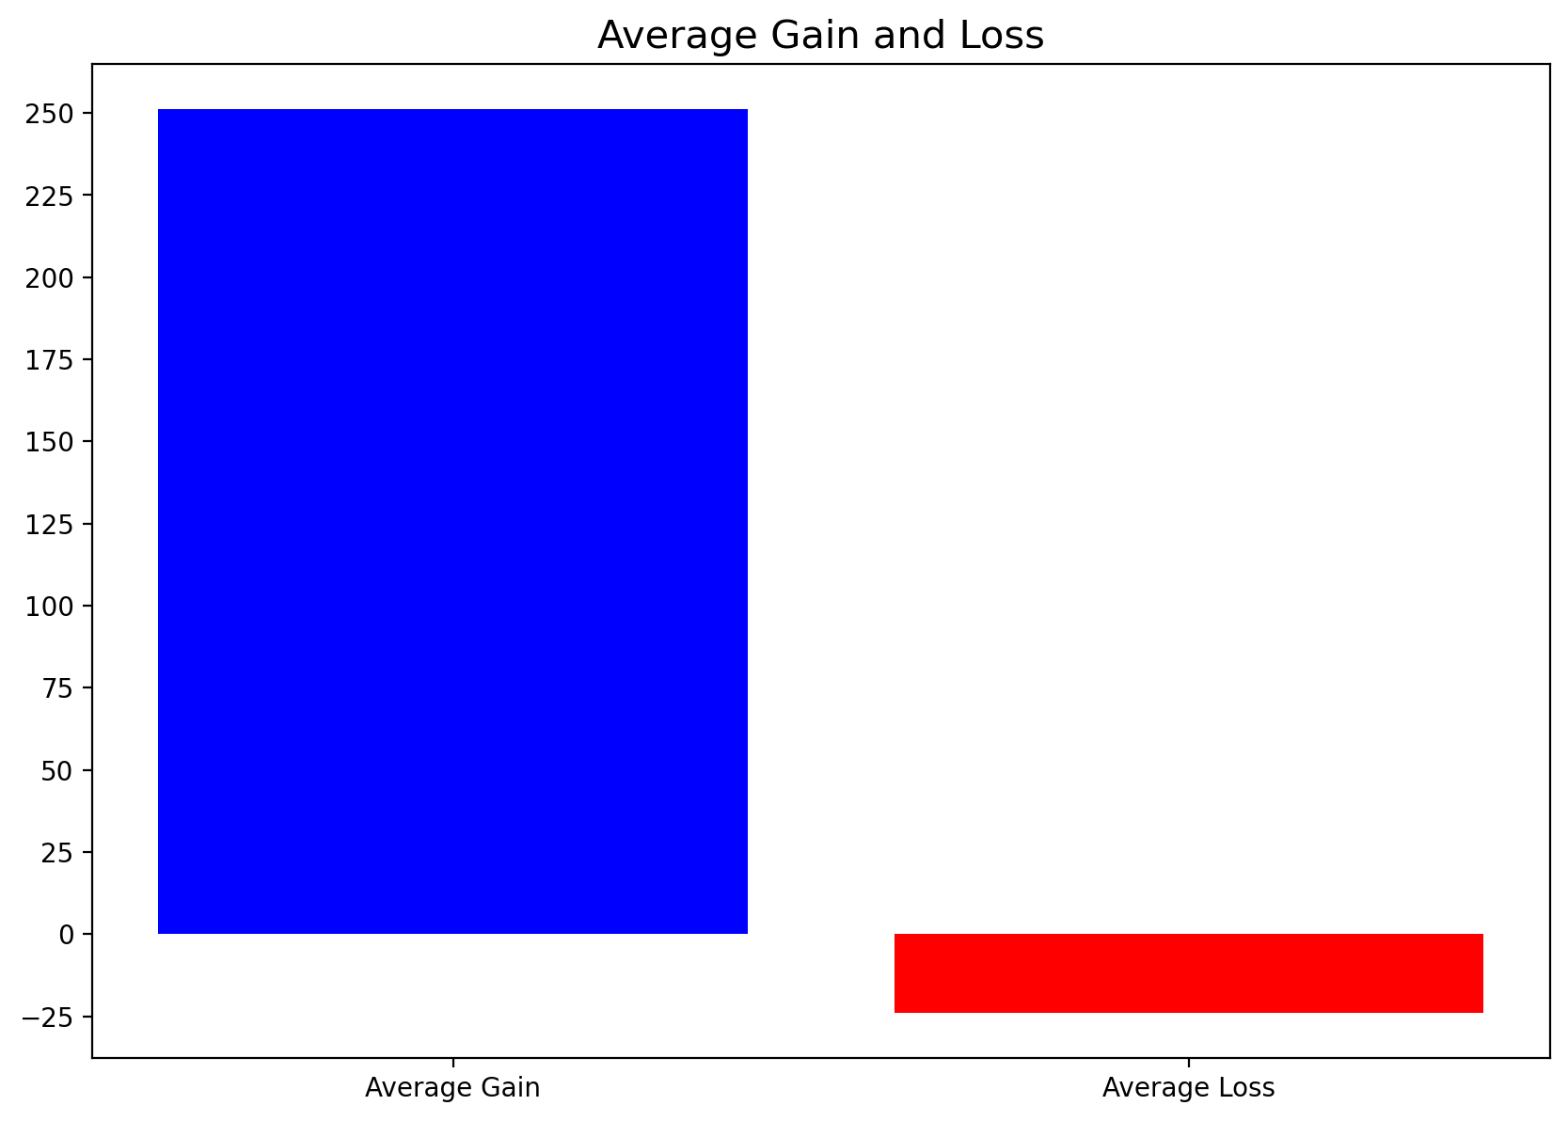
Machine Learning Results

